Slide 1


Huron Grants Post Award Training for the Research Community January 28, 2020

Slide 2

Presenters
Graduate Research IT (GRIT) | DARF Committee | Award Management Office
Chad Macuszonok | Tamara Gabrus | Felecia Sookhoo
Jen Walters | Elise Dantuma | Kelly Belga
 | Ginny Pellam
 | Venessa Nieves

Slide 3

Agenda
Overview and Goals
Huron Terminology
Navigating and Searching
New Award Lifecycle
Award Workflow and States
Creating New Awards
Award Modifications
Award Modification Request vs. Award Modification
Workflows and States
Deliverables
Additional Resources and Office Hours
Demo

Slide 4

Overview and Goals
Review the post award management system functionality in Huron Grants
Examples provided are ‘happy path’ and address the more common scenarios
Business process questions will be noted for senior leadership and addressed as follow-on
Includes content to address frequently asked questions and common mistakes
To create on-going HRS training program for both pre-award and post-award

Slide 5
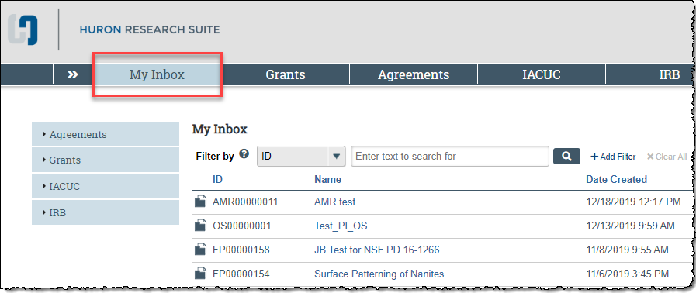
Huron Terminology – My Inbox
Dashboard that contains your do-to list

Slide 6
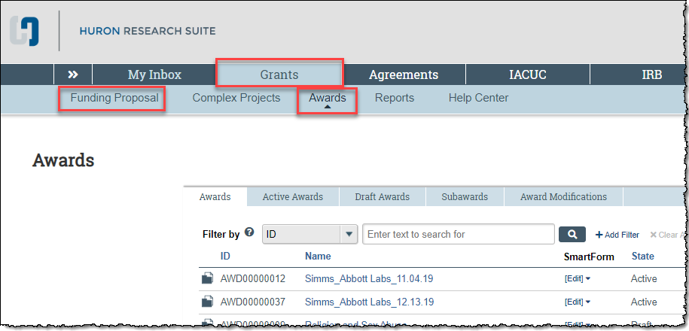
Huron Terminology – Grants tab
Contains all records you have access to
Proposal vs Award tabs

Slide 7
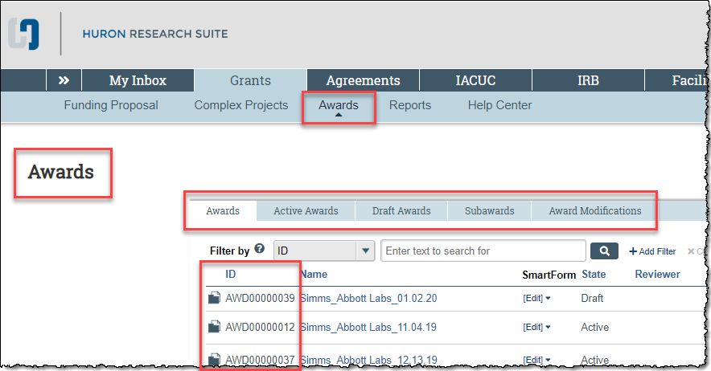
Navigating
Proposals and Awards are listed under two separate tabs

Slide 8
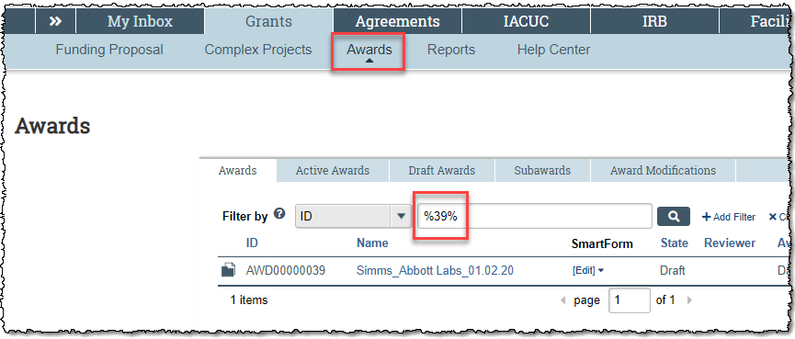
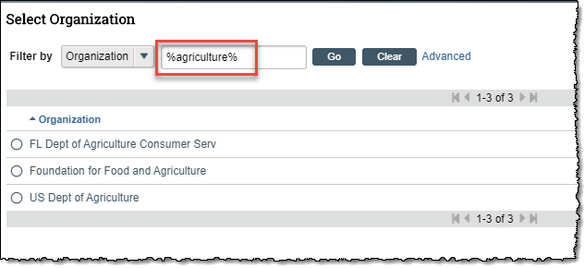
Searching
Remember to use the ‘wild card’ (%) when searching
Detailed instructions are at the beginning of each reference guide in the Help Center

Slide 9
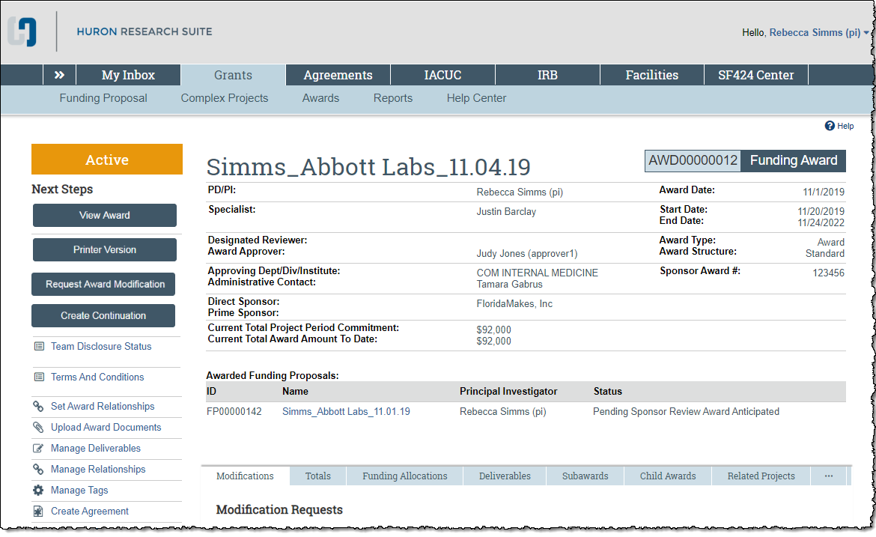
Huron Terminology – Workspace
Profile for a selected record (ID #, state, activities, links)

Slide 10
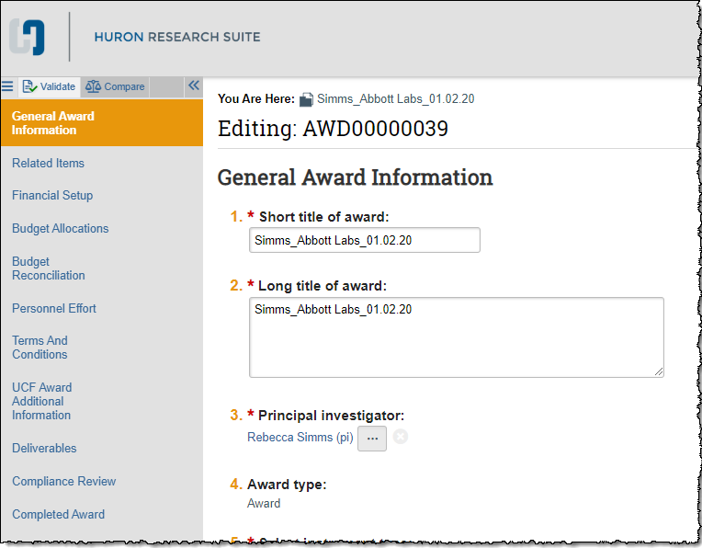
Huron Terminology – SmartForm
Series of pages that contain questions about the record
Use the left navigation page to move between pages

Slide 11
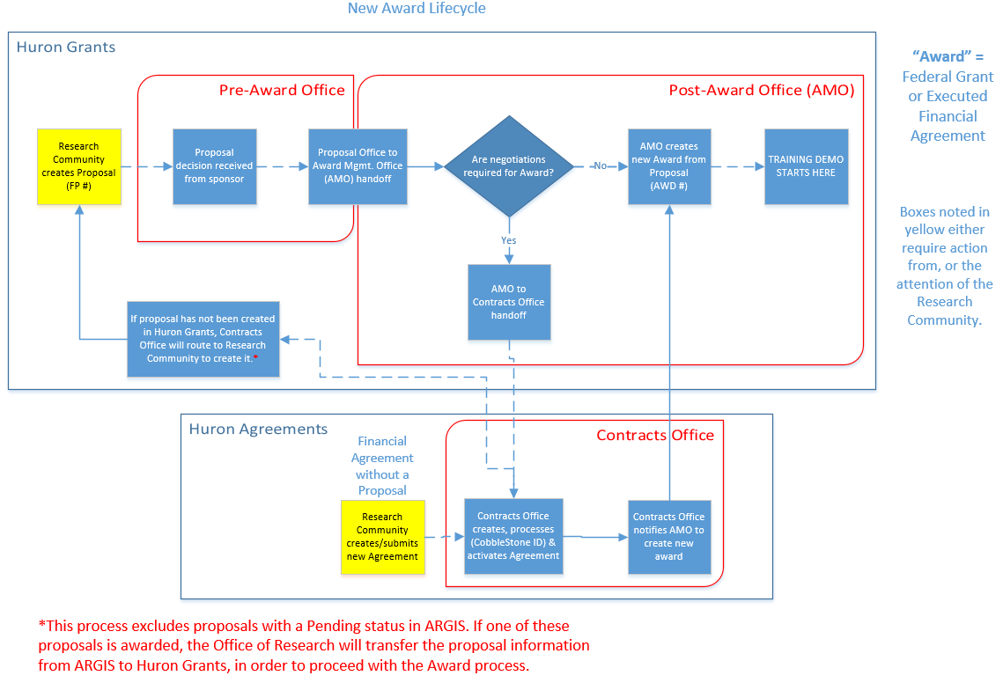

Slide 12
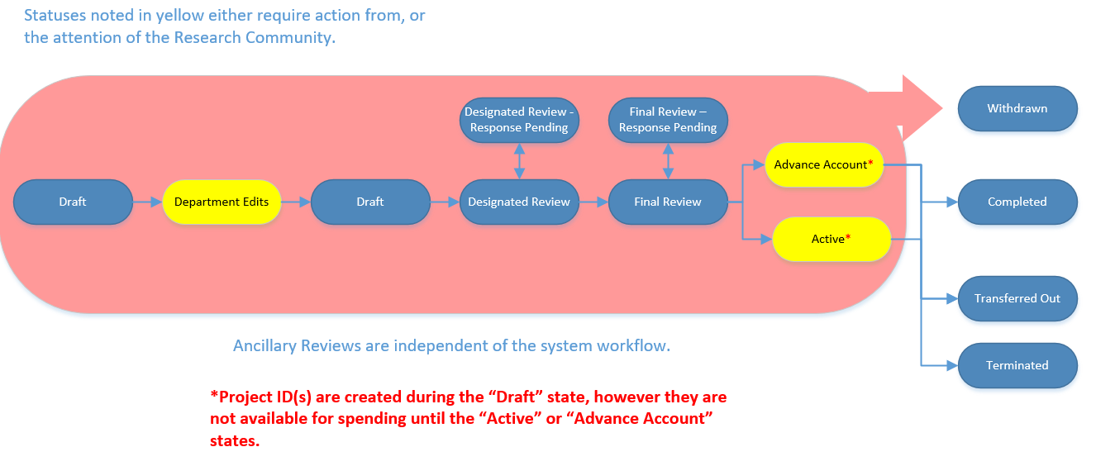
Award Workflow and States

Slide 13
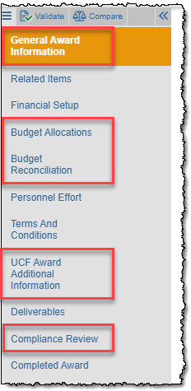
Creating New Awards
“Award” = Federal Grant or Executed Financial Agreement
Awards are created by the Office of Research (“Draft” state)
Award SmartForm pages are completed by both the Office of Research and the Departments
When the Award is in the “Department Edits” state, the department is responsible for completing their pages
Departments complete these pages:
General Award Info (to update Editors, if necessary)
Budget Reconciliation
Personnel Effort
UCF Award Additional Information (Question 2 only)
Compliance Review
Step-by-step instructions in Section 6. “How to Complete Department Edits on the Award” of the Research Community Reference Guide

Slide 14
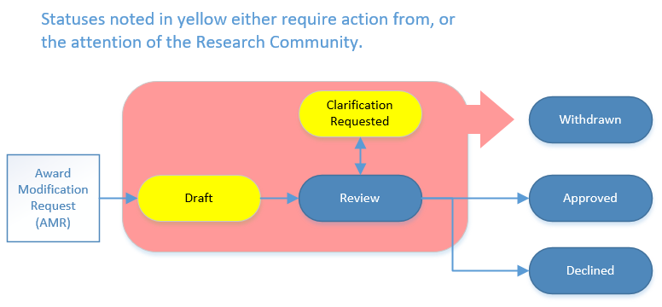
Award Modification Requests (AMR)
The AMR and associated Award Mod are separate records with different states.
Award Modification Request – Created by the research community to notify the Award Mgmt Office a mod is necessary (no longer need to email osp@ucf.edu)

Slide 15
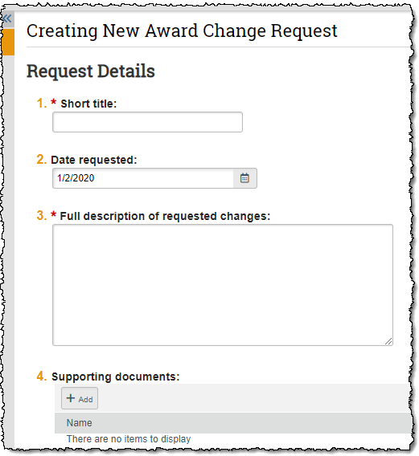
Award Modification Request
Use the “Request Award Modification” button on the Award Workspace
One page SmartForm with four questions
Attach NCE and Budget Transfer Request forms under Question 4. “Supporting documents”.
Forms are located on the Office of Research website: https://www.research.ucf.edu/Research/Forms.html

Slide 16
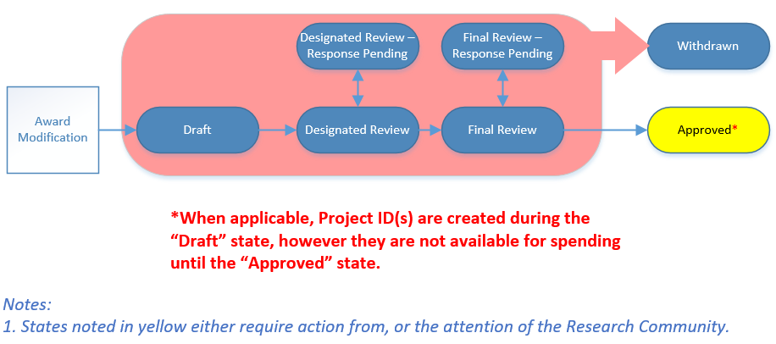
Award Modifications
Award Modifications – Created by the Award Mgmt. Office to track the award modification.

Slide 17
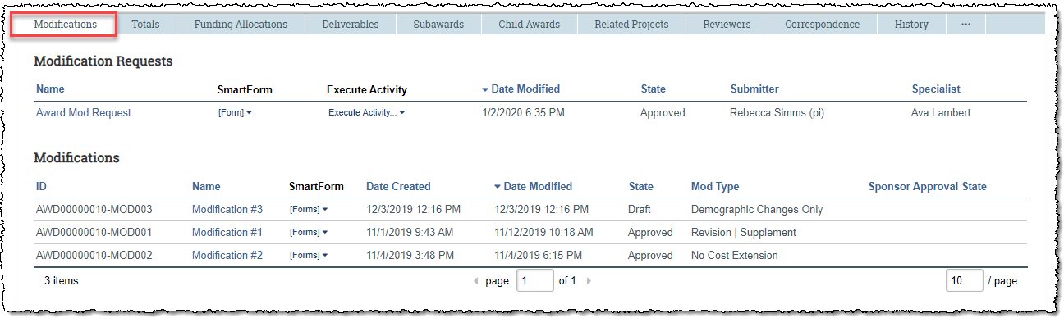
Award Modifications
Review these records on the “Modifications” tab of the Award SmartForm

Slide 18
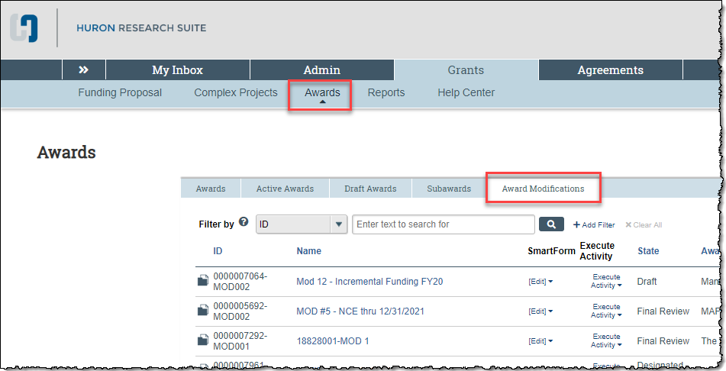
Award Modifications
Award Mod Requests – Review via the “UCF Award Modification Requests Report” (Grants > Reports > Custom Reports)
Award Mods - Review under the Award Modifications tab

Slide 19
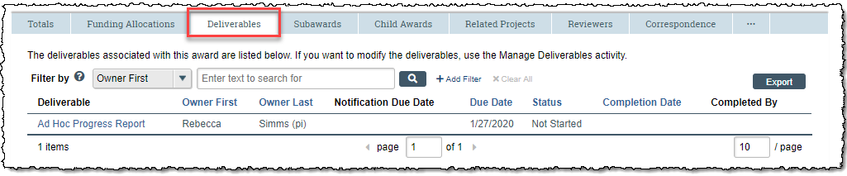
Deliverables
Entered into the system by Award Mgmt. Office. Research Community is responsible for completing.
Deliverables are assigned to a “Responsible Party” and additional staff can be added to receive email notifications. Reminder emails sent 30 and 60 days prior to the Due Date
Subaward deliverables are managed under the parent award
Review on the “Deliverables” tab of the Workspace (search, filter, sort, export)
Use the “Manage Deliverables” activity to add, modify, and/or complete
“Deliverables” AURORA report also available

Slide 20

Additional Resources
Huron Grants Help Center
Grants tab > Help Center tab
Contains reference guides and videos with step-by-step instructions
Wahoo website
https://wahoo.research.ucf.edu
Contains FAQs, ARGIS to Huron Grants Crosswalk (for converted awards), etc.
GRIT Service Desk
For system issues, please open a ticket by sending an email to GRITServiceDesk@ucf.edu. Please include the Huron ID and any screen shots to assist with troubleshooting.

Slide 21

Additional Resources – Office Hours
Live help sessions for hands-on training and practice
Office of Research, DARF, and Research IT staff available on site to assist with questions and issues
Session 1
Wednesday, January 29th from 2 – 4pm
Research Building One, Room 103
Session 2
Monday, February 3rd from 2 – 4pm
Research Building One, Room 103

Slide 22
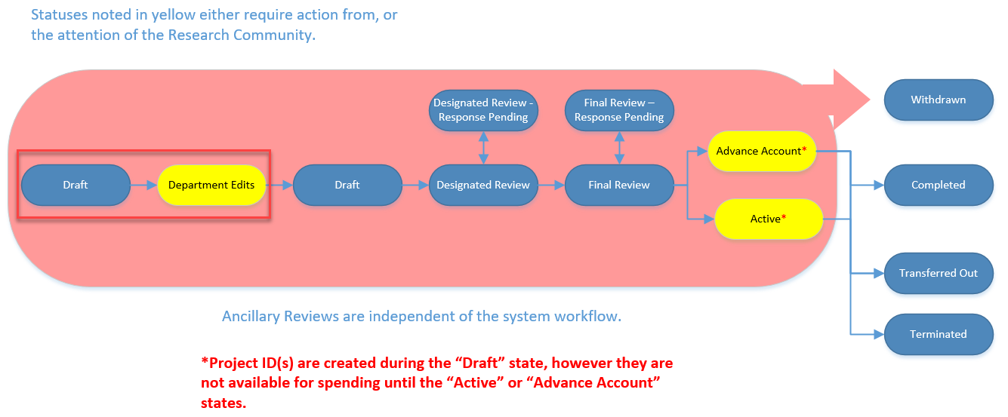
Demo

Slide 23
Demo

Slide 24

Office of Research

